Slide 1


Product Planning & Product Development
To approach the market with our uniqueness and create a trusted partnership with our business partners
BullGuard
(28-Aug-2020)

Slide 2
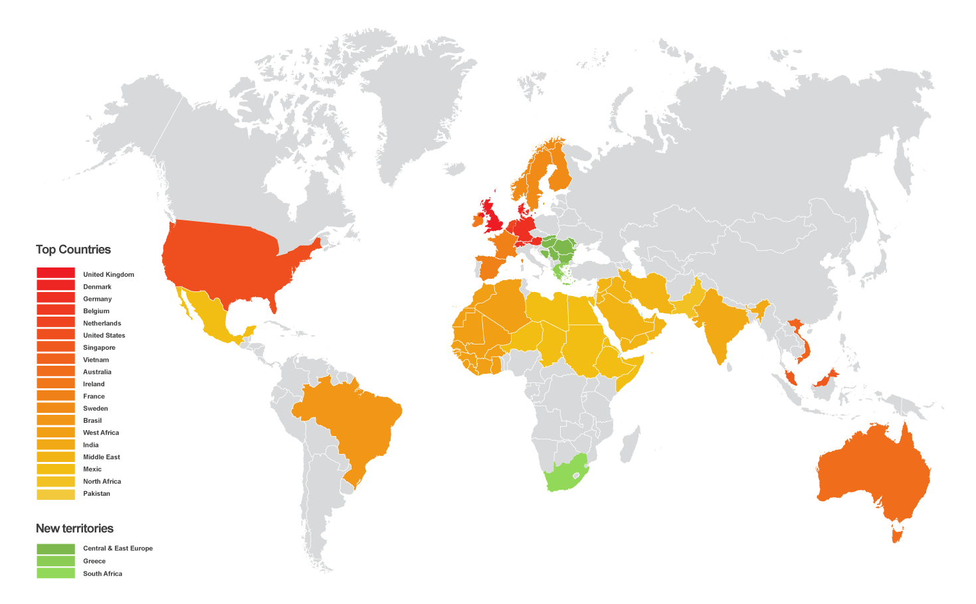
BullGuard Internet Security
Found 2002
British Brand
Market leader in consumer cyber security
Protect your digital life: devices, data, identity & smart home
Extensive IP and technology depth
Customers in 200 countries

Slide 3
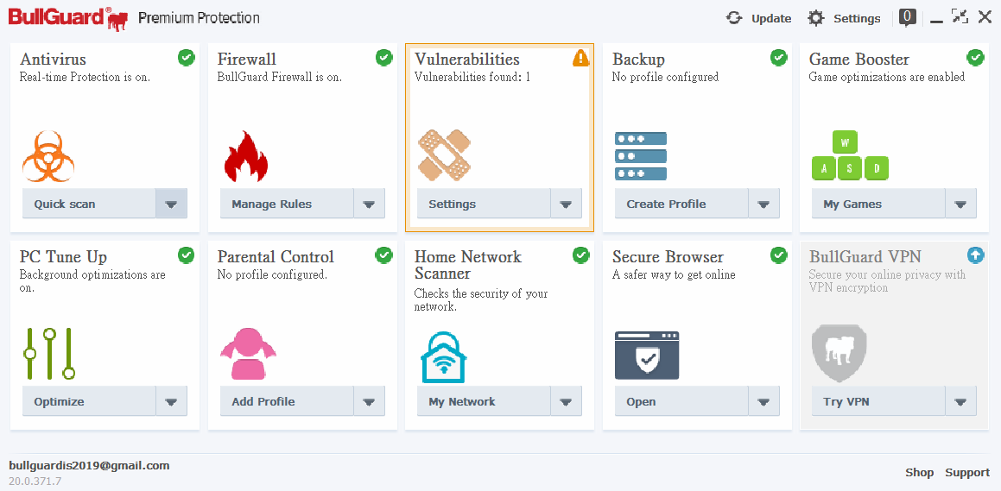
BullGuard Internet Security Features x 9

Slide 4

BullGuard Internet Security Exclusive offer to AVITA
In their official web-page, they just offer 30-DAYS free trial for public
But we can get 6-months free trial with full protection
Following products will be bundled with BullGuard 6-MONTHS full function free trial
LIBER V14

Slide 5
Thank you

